Slide 1
Report on the Machine Learning Implementation.
Index :
Data Preprocessing
Classification Model’s
Decision Tree Classifier
Gaussian Naive Bayes Classifier
K Nearest Neibour Classifier
Logistic Regression Classifier
Multilayer Perceptron Classifier
Random Forest Classifier
Support Vector Classifier
Regression Model’s
Decision Tree Regression
Gradient Boosting Regression
K Nearest Neibour Regression
Lasso Regression
Linear Regression
Multilayer Perceptron Regression
Random Forest Regression
Ridge Regression
Support Vector Regression
Weather Prediction
Rainfall Occurrence Prediction
Weather Forecasting

Slide 2
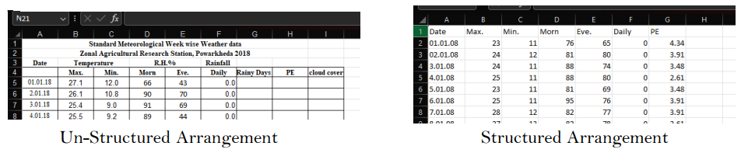
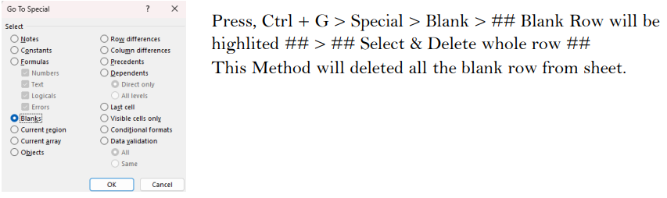
1. Data Preprocessing
Imported Libraries & Modules :
1. Matplotlib.pyplot
2. Seaborn
3. Pandas
4. Numpy
5. OS module
STEP 1 : Data Alignment To arrange the data in a manner that pandas can use it to create a DataFrame & combined csv file that include weather data of all years ( 1996 to 2020 ) without any error I have used Mircosoft Excel sheet ( drag , drop , cut , paste & basic things )
Used Function’s “Go to Special” in Excel Sheet to remove the blank row’s between the data :
After Arranging the data in a Structured form , I renamed the column that have similar column (ET – Evapotranspiration & PE – Potential Evapotranspiration ) since both are related to evaporation I renamed all column named ET to PE.
After this I exported each tab form xls to csv format & I got aligned data for each year in CSV file format.

Slide 3
1. Data Preprocessing
STEP 2 : Creating a single csv file & removing unwanted rows & columns :
Use for loop from python to store each year in a single list called “all_data”.
To skip year 2006 & 2007 use “continue” under loop ( I have skiped this two year because this contain average data of 7 days represented as week, i.e 52 week for 1 year thus 52 rows for a csv file ) .
All csv’s are stored in a single folder called “date wise csv” , join the address of this filder with the name of the each csv file with the help of join function form OS module .
Remove the “Unnamed” columns, this column get created when extra index columns are saved in csv files unintenstionally .
Remove Row’s which have “Average” in “Date” Column since they are not needed & are average of 7 days.
Finally append the list to save.
STEP 3 : Creating DataFrame :
Combine all the dataFrame from the list into a single dataframe using concat().
Save the combined dataFrame into a csv file called “combined_weather_data.csv”.
Check weather the data is stored correctly using head() & tail() function.
Load the combined_weather_data.csv into a variable called “weather”.
STEP 4 : Cleaning of data
“Rainy Days” column can only contain 0 & 1 , but it have values NaN , 20 , 11, which must be removed.
Use isin() & isna() function to select & ~ to remove the selected values .
Remove Rows with values "Average" in column "Date“.
Remove rows with blank spaces in column "Date“.
Removing Duplicate row using “data” column.
Check for any unwanted values in “Rainy Days” column since its label it must contain 0 & 1 , remove others if found .
Remove the column “cloud cover” it mostly contain NaN values ( approx. 7300 values ) .

Slide 4
1. Data Preprocessing
STEP 5 : Convert into numeric values
Conver all the data into numeric values since it’s type object we cannot do math in the data.
weather['Max.'] = pd.to_numeric(weather['Max.'], errors='coerce’).
Coerce here means it will convert into Null values if not convertible into numeric values.
Do same function for all columns .
STEP 6 : Fill Median Values in place of Null Values
Calculate Median for each table.
Like this : median_Max = weather['Max.'].median().
& then replace Null values with the respective Median value of that column.
Like this : weather['Max.'] = weather['Max.'].fillna(median_Max)
STEP 7 : Check for Null values ( If Any ) in the weather data
Use isnull() & sum() function to see the the column wise Null values .
STEP 8 : Export the clean data into a csv file
To export the data into csv format use .to_csv() function.
weather.to_csv('weather_clean_dataSet.csv', index=False)
STEP 9 : Split Train & Test data
Remove columns Year & Date since they are not features of the data.
Choose a large portion of dataset to train model & small portion to test the model.

Slide 5
2. Classification Models
Support Vector Classifier
1.1 Introduction
Decision Tree Classifier is an interpretable machine learning algorithm that creates a tree-like structure of decisions to classify data. In this implementation, the Decision Tree was applied to predict rainy days based on meteorological parameters including temperature readings, rainfall measurements, and potential evaporation data. The algorithm recursively splits the dataset based on feature values that best separate rainy and non-rainy days, making it ideal for weather prediction where understanding the decision-making process is crucial for practical applications.
1.2 Objective
The primary objectives of implementing the Decision Tree Classifier for weather data analysis is:
Binary Classification: To predict whether a given day will be rainy (1) or non-rainy (0) based on meteorological features
1.3 Libraries and Modules Used
The implementation utilized several essential Python libraries with their specific modules:
pandas (pd):
read_csv(): For loading the weather dataset
DataFrame: For data structure and manipulation operations
to_datetime(): For converting date strings to datetime objects
to_csv(): For saving processed data
scikit-learn (sklearn):
DecisionTreeClassifier: Core algorithm implementation for building the decision tree model
train_test_split: For splitting the dataset into training and testing sets
accuracy_score: For calculating model accuracy metrics
confusion_matrix: For generating confusion matrix to evaluate classification performance
plot_tree: For visualizing the complete decision tree structure
matplotlib.pyplot (plt):
pyplot: For creating plots and visualizations
figure(): For setting plot dimensions and properties

Slide 6
2. Classification Models
seaborn (sn):
heatmap(): For creating visually appealing confusion matrix visualization
numpy (np):
For numerical computations and array operations
1.4 Scope and Limitations
Scope:
Dataset Coverage: Analysis of weather data containing temperature readings (Max, Min, Morning, Evening), rainfall data, and potential evaporation measurements
Binary Classification: Focused specifically on predicting rainy vs non-rainy days
Feature Engineering: Extraction of temporal features (year, month, day) from date information
Data Preprocessing: Handling missing values through median imputation
Model Evaluation: Comprehensive assessment using accuracy metrics and confusion matrix analysis
Limitations:
Binary Output: Limited to yes/no rainfall prediction rather than rainfall intensity or duration
Missing Value Treatment: Simple median imputation may not capture complex seasonal patterns in missing data
Overfitting Risk: Decision trees are prone to overfitting, especially with limited hyperparameter tuning
Feature Selection: No systematic feature selection process implemented
1.5 Implementation and Results
Model Training:
Data Splitting: Applied 80-20 train-test split using random state=42 for reproducibility
Model Initialization: Created Decision Tree Classifier with default parameters
Training Process: Fitted the model on training data using all available features except the target variable
Model Performance:
The Decision Tree Classifier achieved the following results:

Slide 7
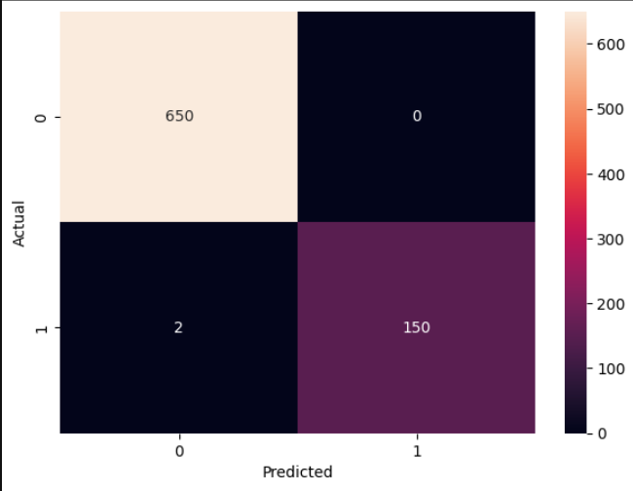
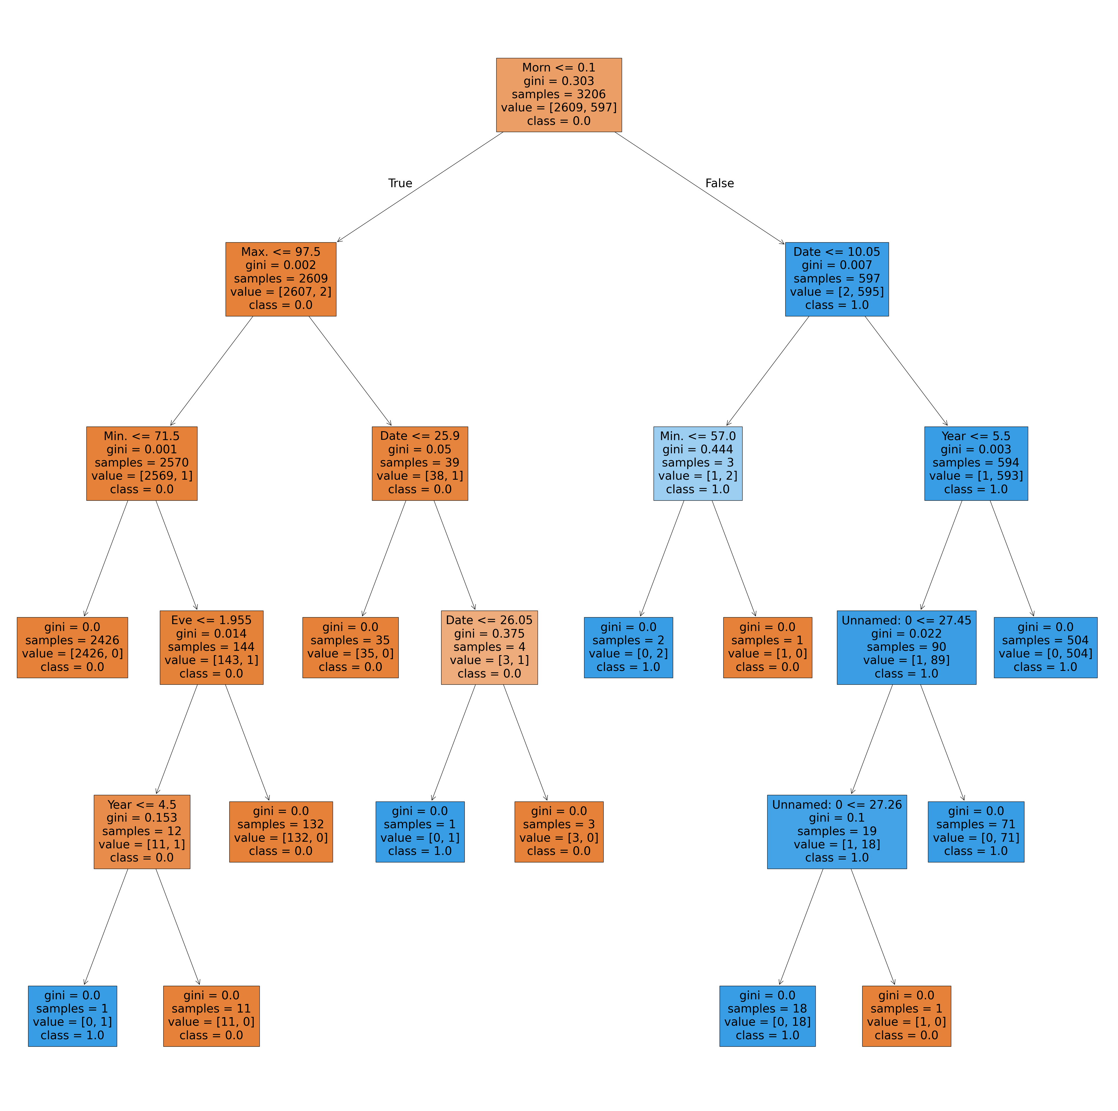
2. Classification Models
Accuracy Score: The model demonstrated strong predictive performance with 99.75% accuracy function
Confusion Matrix Analysis: Generated confusion matrix showing true positives, true negatives, false positives, and false negatives
Visualization: Created comprehensive decision tree plot (50x50 figure size) showing all decision nodes, splits, and leaf classifications

Slide 8
2. Classification Models
2. Gaussian Naive Bayes
2.1 Introduction
Gaussian Naive Bayes is a probabilistic machine learning algorithm based on Bayes' theorem with an assumption of independence between features. In this implementation, the Gaussian Naive Bayes classifier was applied to predict rainy days using preprocessed weather data. The algorithm assumes that continuous features follow a Gaussian (normal) distribution and calculates the probability of each class given the input features, making it particularly suitable for weather prediction tasks where meteorological variables often exhibit normal distributions.
2.2 Objective
The primary objectives of implementing the Gaussian Naive Bayes Classifier is :
Probabilistic Classification: To predict rainy vs non-rainy days using probabilistic inference based on meteorological features
2.3 Libraries and Modules Used
pandas (pd):
DataFrame: Data structure for handling weather data
read_csv(): Loading the preprocessed weather dataset
scikit-learn:
GaussianNB: Core Gaussian Naive Bayes classifier implementation
train_test_split: Splitting dataset into training and testing sets (80-20 split)
confusion_matrix: Generating confusion matrix for performance evaluation
accuracy_score: Calculating classification accuracy metrics
matplotlib.pyplot (plt):
figure(): Setting up plot dimensions for visualizations
xlabel(), ylabel(): Adding axis labels to confusion matrix plot
seaborn (sn):
heatmap(): Creating annotated confusion matrix visualization with color mapping

Slide 9
2. Classification Models
2.4 Scope and Limitations
Scope:
Probabilistic Prediction: Binary classification with probability estimates for each prediction
Performance Evaluation: Comprehensive assessment using confusion matrix and accuracy metrics
Fast Training: Efficient model training suitable for real-time applications
Distribution Assumption: Leverages Gaussian distribution assumption for continuous weather variables
Limitations:
Feature Independence: Strong assumption that all features are conditionally independent (often violated in weather data)
Gaussian Distribution: Assumes all continuous features follow normal distribution
Limited Complexity: Cannot capture complex feature interactions that exist in weather patterns
Binary Classification: Limited to rainy/non-rainy prediction rather than rainfall intensity
Temporal Dependencies: Ignores sequential patterns and seasonal trends in weather data
2.5 Implementation and Results
Data Loading and Preparation:
The implementation utilized the preprocessed weather dataset (ready_to_use_data.csv) containing:
Dataset Size: 4,008 weather observations
Feature Set: 9 input features (Max, Min, Morn, Eve, Rain, PE, year, month, day)
Target Variable: 'Rainy Days' (binary: 0 = no rain, 1 = rain)
Data Split: 80% training (3,206 samples), 20% testing (802 samples)

Slide 10
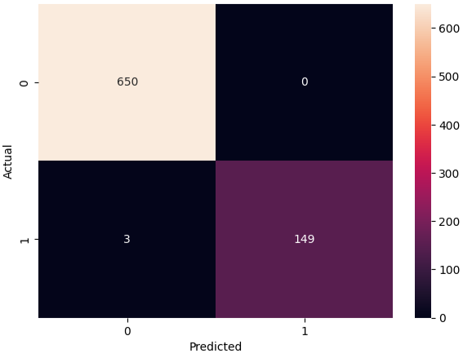
2. Classification Models
2.6 Model Configuration:
Algorithm: Gaussian Naive Bayes with default scikit-learn parameters
Training: Direct fit on training data without feature scaling
Assumptions: Features assumed to follow Gaussian distribution and be conditionally independent
2.7 Performance Results:
The Gaussian Naive Bayes classifier achieved exceptional performance:
Accuracy Score: 99.63% (798 correct predictions out of 802 test samples)

Slide 11
2. Classification Models
3. K-Nearest Neighbour Classification
3.1 Introduction
This report presents an analysis of a K-Nearest Neighbors (KNN) classification model implemented to predict rainy days based on weather parameters. The project utilizes a weather dataset containing various meteorological features to build a predictive model that can classify whether a particular day will experience rainfall or not.
The implementation demonstrates the application of machine learning techniques for weather prediction, specifically using the KNN algorithm which is a simple yet effective non-parametric method for classification tasks.
3.2 Objective
The primary objective of this project is to:
Build a classification model to predict rainy days based on weather parameters
Evaluate the performance of the K-Nearest Neighbors algorithm on weather data
Assess the model's accuracy in distinguishing between rainy and non-rainy days
Demonstrate the practical application of KNN for meteorological prediction tasks
3.3 Libraries and Modules Used
The following Python libraries and their specific modules were utilized in this implementation:
pandas: For data manipulation and analysis
seaborn: For advanced data visualization and statistical plotting
matplotlib.pyplot: For creating plots and visualizations
sklearn: Comprehensive machine learning library containing:
train_test_split: For splitting the dataset into training and testing sets
confusion_matrix: For generating confusion matrix to evaluate classification performance
accuracy_score: For calculating the accuracy of the model predictions
KNeighborsClassifier: The main KNN algorithm implementation for classification

Slide 12
2. Classification Models
3.4 Scope and Limitations
Scope:
Binary classification of weather conditions (rainy vs non-rainy days)
Performance evaluation using confusion matrix and accuracy metrics
Hyperparameter optimization through parameter tuning
Limitations:
Limited to binary classification (rainy/non-rainy) rather than multi-class weather prediction
Limited feature engineering - uses raw meteorological data without derived features
Missing data handling not explicitly addressed
3.5 Implementation and Results
Data Preprocessing:
Dataset loaded with 4,008 rows and 10 columns
Feature matrix (X) created by dropping the target variable 'Rainy Days'
Target variable (y) set as 'Rainy Days' column
Data split using train_test_split with 80-20 ratio (test_size=0.2)
Model Configuration and Hyperparameters:
The KNN classifier was configured with the following hyperparameters:
n_neighbors = 5: Uses 5 nearest neighbors for classification decision
Rationale: Default value providing good balance between bias and variance
leaf_size = 30: Controls the speed of construction and query, as well as memory usage
Impact: Affects algorithm efficiency for large datasets
p = 3: Uses Minkowski distance with p=3 (custom distance metric)
Significance: Deviates from standard Euclidean (p=2) or Manhattan (p=1) distance
Effect: Provide better discrimination for this weather dataset

Slide 13
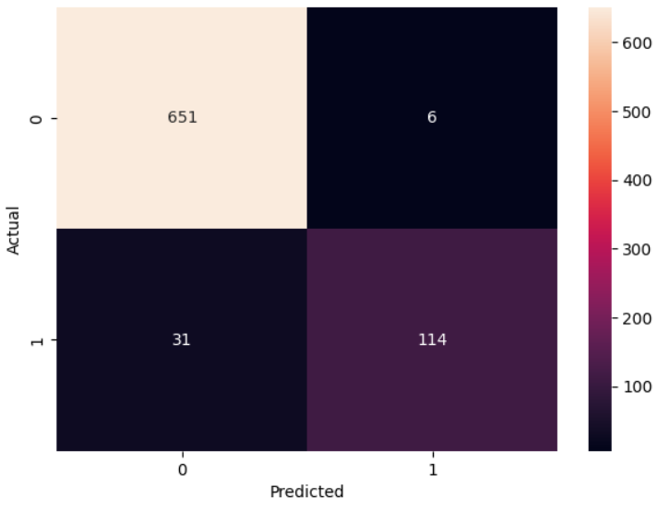
2. Classification Models
weights = 'uniform': All neighbors weighted equally (default)
algorithm = 'auto': Automatically selects the best algorithm for the dataset
metric = 'minkowski': Distance metric used for neighbor calculation
3.6 Results
Performance Metrics:
Overall Accuracy: 95.39%
True Negatives (No Rain correctly predicted): 651
False Positives (Incorrectly predicted rain): 6
False Negatives (Missed rainy days): 31
True Positives (Correctly predicted rain): 114

Slide 14
2. Classification Models
4. Logistic Regression Classifier
4.1 Introduction
This report presents an analysis of a logistic regression classification model applied to weather data prediction. The project implements a binary classification system to predict rainy days using various meteorological features including temperature, humidity, rainfall, and evapotranspiration data. The model demonstrates the application of supervised machine learning techniques for weather pattern recognition and prediction.
4.2 Objective
The primary objective of this project is to develop a predictive model that can accurately classify whether a given day will have rainfall (rainy days) based on historical weather parameters. Specifically, the model aims to:
Predict the occurrence of rainy days using meteorological features
Achieve high classification accuracy for weather prediction
Demonstrate the effectiveness of logistic regression for binary weather classification
Provide a reliable tool for weather forecasting applications
4.3 Libraries & Modules Used
The following Python libraries and modules were utilized in this implementation:
Data Manipulation and Analysis
pandas: For data loading, manipulation, and DataFrame operations
numpy: For numerical computations and array operations
Machine Learning
sklearn.linear_model.LogisticRegression: Core logistic regression algorithm
sklearn.model_selection.train_test_split: For splitting dataset into training and testing sets
sklearn.metrics.accuracy_score: For model performance evaluation
sklearn.metrics.confusion_matrix: For detailed classification analysis
Data Visualization
matplotlib.pyplot: For basic plotting and visualization
seaborn: For enhanced statistical visualizations, particularly the confusion matrix heatmap

Slide 15
2. Classification Models
4.4 Scope and Limitations
Scope
Feature Set: Utilizes 9 meteorological features including temperature (Max, Min), humidity (Morning, Evening), rainfall, and evapotranspiration data
Classification Type: Binary classification for predicting rainy days
Limitations
Binary Classification: Only predicts presence/absence of rain, not rainfall intensity
Temporal Dependencies: Does not account for sequential weather patterns or seasonality
External Factors: Does not incorporate additional meteorological factors like wind speed, atmospheric pressure, or cloud cover
4.5 Implementation
Model Training Process
Feature Selection: All variables except 'Rainy Days' used as predictors
Data Splitting: 80% training, 20% testing split using random sampling
Model Architecture: Logistic Regression with default parameters
Hyperparameters
The logistic regression model was configured with the following hyperparameter modification:
Parameter | Value | Justification
max_iter | 1000 | Increased from default 100 iterations to ensure model convergence
solver | 'lbfgs' | Default solver maintained for binary classification
penalty | 'l2' | Default L2 regularization maintained
C | 1.0 | Default regularization strength maintained

Slide 16
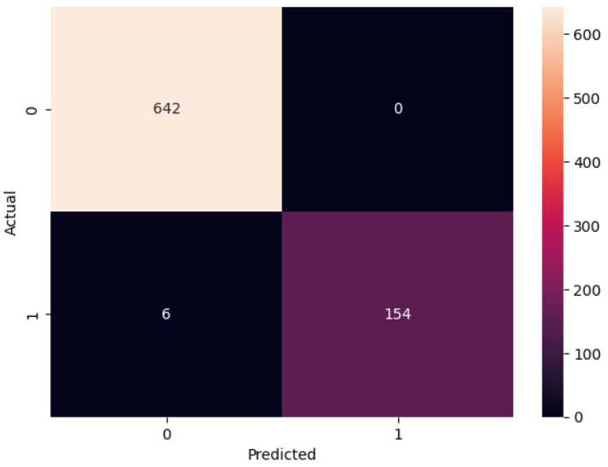
2. Classification Models
4.6 Results
Model Performance
The logistic regression model achieved exceptional performance with an accuracy of 99.25% on the test dataset. This high accuracy indicates strong predictive capability for weather classification.
Performance Metrics
Overall Accuracy: 99.25%
True Negatives: 642 (correctly predicted no rain)
True Positives: 154 (correctly predicted rain)
False Negatives: 6 (missed rainy days)
False Positives: 0 (no false alarms)

Slide 17
2. Classification Models
5. Multilayer Perceptron Classifier
5.1 Introduction
This report presents an analysis of a Multi-layer Perceptron (MLP) classifier implementation for weather data prediction. The study focuses on predicting rainy days using various meteorological features including temperature, humidity, rainfall, and potential evaporation measurements. The MLP neural network model was trained and evaluated on a weather dataset spanning multiple months in 2020.
5.2 Objective
The primary objective of this project is to develop and evaluate a neural network-based classification model that can accurately predict rainy days based on meteorological parameters. Specifically, the model aims to:
Classify weather patterns to predict the occurrence of rainy days
Achieve high prediction accuracy using multi-layer perceptron architecture
Evaluate model performance using confusion matrix and accuracy metrics
Demonstrate the effectiveness of neural networks in weather prediction tasks
5.3 Libraries & Modules Used
The implementation utilized the following Python libraries and modules:
Core Libraries:
pandas: Data manipulation and analysis
sklearn.model_selection: Train-test data splitting (train_test_split)
sklearn.metrics: Model evaluation metrics (confusion_matrix, accuracy_score)
sklearn.preprocessing: Data preprocessing (StandardScaler)
sklearn.neural_network: Neural network implementation (MLPClassifier)
Visualization Libraries:
matplotlib.pyplot: Basic plotting functionality
seaborn: Statistical data visualization (confusion matrix heatmap)

Slide 18
2. Classification Models
5.4 Scope and Limitations
Scope:
Features: Maximum/minimum temperature, morning/evening humidity, rainfall, rainy days, potential evaporation, and date components
Model Type: Multi-layer Perceptron binary classifier
Evaluation Method: Train-test split (80-20 ratio) with confusion matrix analysis
Limitations:
High-Quality Data Dependency: MLPs require large amounts of clean, well-preprocessed data to perform effectively. They're sensitive to noisy, incomplete, or poorly scaled input features, which can significantly degrade classification performance.
Feature Scaling Sensitivity: Input features must be properly normalized or standardized. Different scales across features can cause certain inputs to dominate the learning process, leading to poor convergence and biased classifications.
5.5 Implementation
Hyperparameter Configuration:
The MLP classifier was configured with the following hyperparameters:
hidden_layer_sizes: 100 neurons in single hidden layer
activation: 'logistic' (sigmoid activation function)
solver: 'adam' (default - adaptive moment estimation optimizer)
max_iter: 200 (default - maximum iterations)
random_state: None (not set for reproducibility)
Note: In implementation ( see on the ipynb file ) , comments indicate that without the hidden_layer_sizes parameter, accuracy was only 54%, demonstrating the importance of proper architecture design.
Model Training and Evaluation:
Data Splitting: 80% training (3,206 samples) and 20% testing (802 samples)
Model Training: MLPClassifier fitted on training data
Prediction: Model predictions generated on test set
Evaluation: Performance assessed using confusion matrix and accuracy score

Slide 19
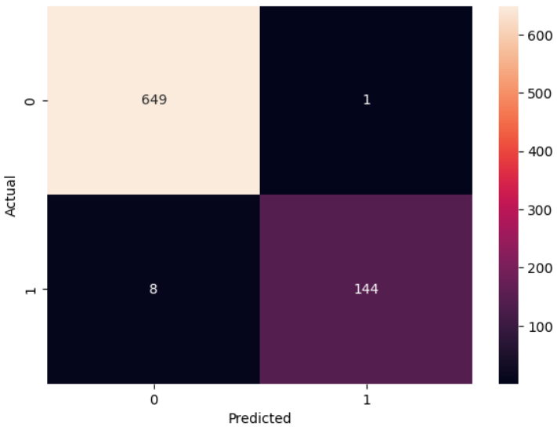
2. Classification Models
5.6 Results
Model Performance Assessment:
Exceptional Accuracy: 98.88% overall accuracy demonstrates excellent predictive capability
Low False Positive Rate: Only 1 false positive indicates minimal over-prediction of rain
Strong True Negative Rate: 649/650 non-rainy days correctly identified (99.85%)
Good True Positive Rate: 144/152 rainy days correctly identified (94.74%)

Slide 20
2. Classification Models
6. Random Forest Classifier
6.1 Introduction
This section of report presents the development and evaluation of a Random Forest classifier for weather prediction. The model utilizes historical weather data to predict rainy days based on various meteorological parameters including temperature, humidity, rainfall, and potential evaporation measurements.
6.2 Objective
The primary objective of this project is to build a machine learning model that can accurately predict rainy days using weather-related features. The Random Forest algorithm was employed to classify weather conditions and determine the likelihood of precipitation occurrence based on historical weather patterns.
6.3 Libraries & Modules Used
The following Python libraries and modules were utilized in this implementation:
pandas: Data manipulation and analysis, used for loading and handling the CSV dataset
scikit-learn: Machine learning library providing:
RandomForestClassifier: Core algorithm implementation
train_test_split: Data splitting functionality
confusion_matrix: Model evaluation metric
accuracy_score: Performance measurement
matplotlib.pyplot: Data visualization for plotting results
seaborn: Statistical data visualization, specifically for confusion matrix heatmap
6.4 Scope and Limitations
Scope of Random Forest Algorithm:
Ensemble Learning: Combines multiple decision trees to improve prediction accuracy and reduce overfitting
Feature Importance: Provides insights into which weather parameters are most influential in predictions
Robustness: Handles missing values and maintains accuracy when dealing with large datasets.

Slide 21

2. Classification Models
Versatility: Suitable for both classification and regression tasks
Non-parametric: Makes no assumptions about underlying data distribution
Limitations of Random Forest Algorithm:
Interpretability: Less interpretable than single decision trees due to ensemble nature
Memory Usage: Requires more computational resources and memory compared to simpler algorithms
Overfitting Risk: Can overfit with very noisy datasets despite built-in regularization
Bias towards Categorical Variables: May favor categorical features with more levels
Real-time Prediction: Slower prediction time compared to simpler models due to multiple tree evaluations
6.5 Implementation and Results
Hyperparameters:
The Random Forest model was configured with the following hyperparameter:
n_estimators: 30 (number of decision trees in the forest)
All other parameters remained at scikit-learn default values
Performance Metrics:
Overall Accuracy: 99.88%
True Negatives: 634 (correctly predicted non-rainy days)
True Positives: 167 (correctly predicted rainy days)
False Negatives: 1 (missed rainy day)
False Positives: 0 (no false alarms)

Slide 22
2. Classification Models
7. Support Vector Classification
7.1Introduction
This section of report presents an analysis of a Support Vector Machine (SVM) classification model implemented for weather data prediction. The project focuses on predicting rainy days using various meteorological parameters including temperature, humidity, rainfall, and potential evaporation data. The implementation utilizes Python's scikit-learn library to build and evaluate a linear SVM classifier.
7.2 Objective
The primary objective of this project is to develop a machine learning model capable of accurately predicting whether a given day will experience rainfall based on historical weather data. The specific goals include:
Build a binary classification model to predict rainy days (0 = No rain, 1 = Rain)
Achieve high accuracy in weather prediction using SVM algorithm
Evaluate model performance using confusion matrix and accuracy metrics
Demonstrate the effectiveness of feature scaling in SVM implementation
7.3 Libraries & Modules Used
The following Python libraries and modules were utilized in this implementation:
pandas: Data manipulation and analysis
scikit-learn modules:
train_test_split: Dataset splitting for training and testing
confusion_matrix: Model evaluation metric
accuracy_score: Performance measurement
SVC: Support Vector Classifier implementation
StandardScaler: Feature scaling and normalization
matplotlib.pyplot: Data visualization and plotting
seaborn: Statistical data visualization for confusion matrix heatmap
7.4 Scope and Limitations
Scope of SVM Algorithm:
Binary and Multi-class Classification: Effective for both binary and multi-class problems
High-dimensional Data: Performs well with high-dimensional feature spaces
Non-linear Decision Boundaries: Can handle complex patterns through kernel functions

Slide 23
2. Classification Models
Robust to Outliers: Less sensitive to outliers compared to other algorithms
Memory Efficient: Uses subset of training points (support vectors) for predictions
Limitations of SVM Algorithm:
Feature Scaling Dependency: Requires careful feature scaling for optimal performance
Computational Complexity: Training time increases significantly with large datasets (O(n³))
Parameter Sensitivity: Performance heavily depends on hyperparameter tuning (C, gamma, kernel)
Probability Estimates: Does not directly provide probabilistic outputs
Interpretability: Less interpretable compared to decision trees or linear regression
Memory Usage: Can be memory-intensive for large datasets during training
7.5 Implementation and Results
Feature Scaling
StandardScaler was applied to normalize all features, which is crucial for SVM performance:
scaler = StandardScaler()
x_train_scaled = scaler.fit_transform(x_train)
x_test_scaled = scaler.transform(x_test)
Hyperparameters
The SVM model was configured with the following hyperparameter:
Kernel: Linear kernel was selected for optimal performance
C: Default value of 1.0 (regularization parameter)
Other parameters: Default scikit-learn values
Note: The notebook ( .ipynb file ) specifically mentions that using a linear kernel is crucial for achieving 99% accuracy it show the importance of hyperparameter tuning.
Model Training and Evaluation
The Support Vector Classifier was trained on the scaled training data and evaluated on the test set.

Slide 24

2. Classification Models
7.6 Results
Performance Metrics:
Accuracy Score: 99.38%
True Negatives: 650 (correctly predicted non-rainy days)
True Positives: 147 (correctly predicted rainy days)
False Negatives: 5 (missed rainy days)
False Positives: 0 (no false alarms)

Slide 25
3. Regression Model’s
Decision Tree Regressor
1.1 Introduction
This section of report demonstrates the implementation of a Decision Tree Regression model to predict next day's minimum and maximum temperatures using historical weather data. The model utilizes a MultiOutputRegressor to handle multiple target variables simultaneously.
1.2 Objective
Develop a predictive model for forecasting next day's minimum and maximum temperatures
Utilize weather data features like current temperatures, humidity, rainfall, etc.
Implement a Decision Tree Regression approach
Evaluate model performance using standard regression metrics
1.3 Libraries & Modules Used
The implementation uses the following Python libraries:
Pandas: For data manipulation and analysis
NumPy: For numerical operations
Matplotlib & Seaborn: For data visualization
Scikit-learn modules:
DecisionTreeRegressor: The regression model
MultiOutputRegressor: For multi-target regression
train_test_split: For splitting data into training and test sets
mean_absolute_error, mean_squared_error, r2_score: For model evaluation
1.4 Scope and Limitations
Scope
Captures non-linear relationships: Decision Trees work well for data with non-linear and complex relationships.
Interpretability: Easy to visualize and understand how predictions are made.
Multi-output prediction: Can predict both minimum and maximum temperatures simultaneously.
No need for feature scaling: Works directly with raw values.
3. Libraries & Modules Used

Slide 26
3. Regression Model’s
Limitations
Overfitting: Decision Trees tend to memorize training data, reducing generalization ability.
Instability: Small changes in data can lead to very different trees.
Limited accuracy on continuous data: While good for classification, regression trees may not capture smooth temperature trends well compared to ensemble methods (Random Forest, Gradient Boosting).
Extrapolation issue: Trees cannot predict values outside the observed data range
1.5 Implementation and Results
Data Preparation :
Loaded weather dataset (ready_to_use_data.csv).
Created new columns Next_Max and Next_Min for prediction targets.
Removed rows with missing values after shifting.
Final dataset saved as ready_to_use_data_for_regression.csv.
Model Training :
Features: Current day’s Max and Min temperatures.
Targets: Next day’s Max and Min temperatures.
Used DecisionTreeRegressor wrapped in MultiOutputRegressor.
Split dataset into training and testing sets using train_test_split.
Hyperparameters :
The model uses:
max_depth=250 (to allow deep trees while avoiding overfitting).
min_samples_split=4 (to ensure sufficient samples for splits).
max_features='sqrt' (to reduce feature selection bias).

Slide 27
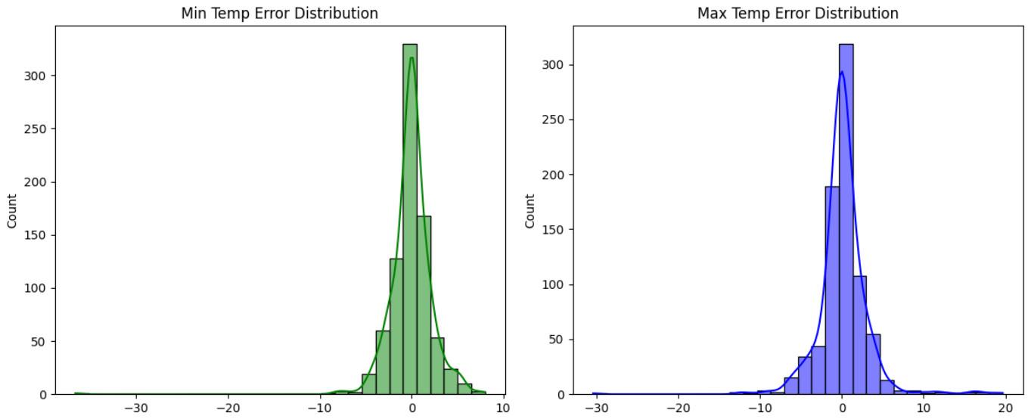
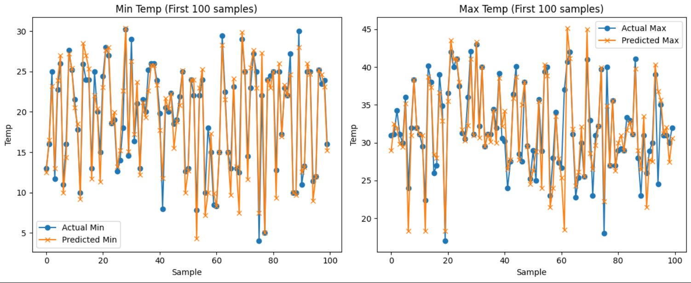
3. Regression Model’s
1.6 Results :
MAE: 1.66 °C
MSE: 7.93
RMSE: 2.82 °C
R² Score: 0.78

Slide 28
3. Regression Model’s
2 . Gradient Boosting Regressor
2.1 Introduction
This project develops a multi-output regression model using Gradient Boosting to predict the next day's minimum (Next_Min) and maximum (Next_Max) temperatures based on historical weather data. The dataset includes features like current-day temperatures, humidity, rainfall, and date information.
2.2 Objective
Primary Goal:
To build an accurate predictive model that simultaneously forecasts Next_Min and Next_Max temperatures using a Gradient Boosting Regressor.
Key Tasks:
Train a MultiOutputRegressor with GradientBoostingRegressor as the base estimator.
Evaluate model performance on test data.
2.3 Libraries & Modules Used
Core Libraries:
Pandas: Data loading/manipulation (pd.read_csv, DataFrame).
NumPy: Numerical operations (np).
Matplotlib/Seaborn: Visualization (plt, sns).
Scikit-learn:
Metrics: mean_absolute_error, mean_squared_error, r2_score.
Model selection: train_test_split.
Ensemble: GradientBoostingRegressor.
Multi-output: MultiOutputRegressor

Slide 29
3. Regression Model’s
2.4 Scope and Limitations of the Algorithm
Scope:
Multi-output Support: Handles prediction of two targets (Next_Min, Next_Max) via MultiOutputRegressor.
Non-linearity Capture: Gradient Boosting effectively models complex relationships in weather data.
Hyperparameter Control: Uses max_features='sqrt' to reduce overfitting and validation_fraction=0.5 for robust validation.
Limitations:
Computational Cost: Training 150 trees (n_estimators=150) is resource-intensive.
Overfitting Risk: Despite max_features='sqrt', hyperparameters were not tuned (e.g., no GridSearchCV), risking suboptimal generalization.
Feature Dependency: Performance relies heavily on feature quality (e.g., temporal patterns in weather data).
No Cross-Validation: Lack of k-fold validation may inflate performance metrics
2.5 Implementation, Hyperparameters, and Results
Data Loading:
Dataset: ready_to_use_data_for_regression.csv (4,007 rows, 12 features).
Features: Max., Min., Morn, Eve, Rain, Rainy Days, PE, year, month, day.
Targets: Next_Min, Next_Max.
Train-Test Split: 80% training, 20% testing (random_state=42).
Hyperparameters:
Parameter Value Role
n_estimators 150 Number of boosting trees.
max_features 'sqrt’ Features per split (√n_features).
validation_fraction 0.5 Fraction of training data used for validation.

Slide 30
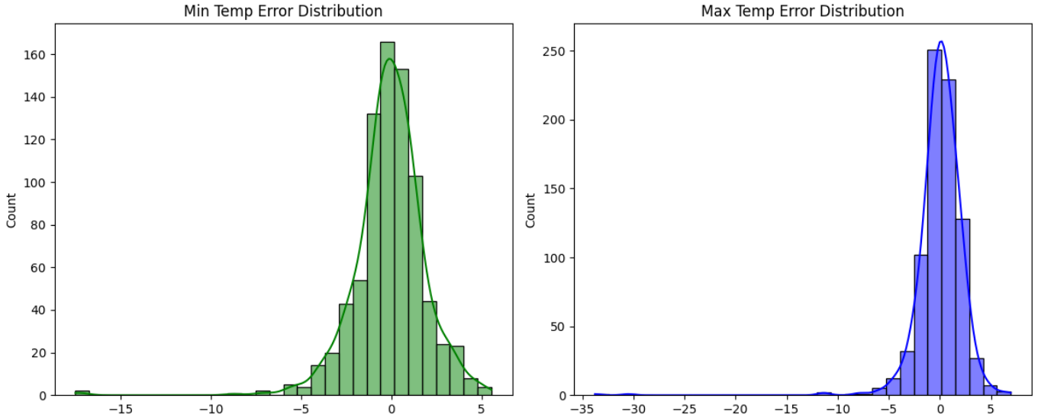
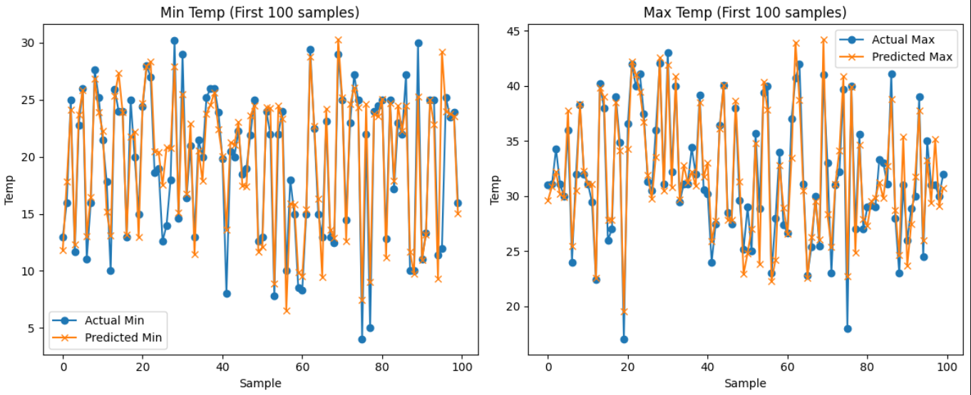
3. Regression Model’s
2.6 Results :
MAE: 1.42 °C
MSE: 5.06
RMSE: 2.25 °C
R² Score: 0.86

Slide 31
3. Regression Model’s
3. K Nearest Neighbour Regressor
3.1 Introduction
This report details a machine learning project that uses the K-Nearest Neighbors (KNN) Regressor algorithm to predict weather data. The model is trained on a dataset containing various weather attributes to forecast the next day's maximum and minimum temperatures.
3.2 Objective
The primary goal of this project is to build and evaluate a regression model using the K-Nearest Neighbors algorithm. The model's specific task is to predict two continuous output variables, Next_Max and Next_Min.
3.3 Library & Module Used
The following Python libraries and modules were used for data handling, model building, and evaluation:
pandas: For data manipulation and analysis.
seaborn and matplotlib.pyplot: For data visualization.
numpy: For numerical operations.
sklearn.metrics: To calculate evaluation metrics like Mean Absolute Error (MAE), Mean Squared Error (MSE), Root Mean Squared Error (RMSE), and R² Score.
sklearn.model_selection: To split the data into training and testing sets.
sklearn.neighbors: To import KNeighborsRegressor for the KNN model.
sklearn.multioutput: To import MultiOutputRegressor, which allows the model to predict multiple target variables.
3.4 Scope and Limitations
Scope:
The K-Nearest Neighbors algorithm is a non-parametric method. It is effective for tasks where the decision boundary is complex and not easily defined by a linear model. Its simplicity and interpretability make it a good baseline model for many regression problems.
Limitations:
Curse of Dimensionality: KNN's performance degrades as the number of features (dimensions) increases. The distance calculation becomes less meaningful, and the algorithm becomes computationally expensive.

Slide 32
3. Regression Model’s
Computational Cost: KNN requires storing the entire training dataset in memory. This can be very slow and memory-intensive for large datasets, as it has to calculate the distance between a new data point and every existing data point during prediction.
Sensitive to Feature Scaling: The performance of KNN is highly dependent on the scale of the features. Features with larger scales can have a disproportionately large effect on the distance calculation.
Outliers: The algorithm is sensitive to noise and outliers, as a single outlier can significantly affect the prediction of its nearest neighbors.
Hyperparameters
The key hyperparameter for this model is n_neighbors , which was set to 5. This value determines the number of nearest data points considered for each prediction. The choice of 5 is a common starting point, but it can be tuned to optimize the model's performance.
3.5 Results :
The model's performance was evaluated using several metrics on the test set:
MAE (Mean Absolute Error): 1.75 °C
MSE (Mean Squared Error): 9.11
RMSE (Root Mean Squared Error): 3.02 °C
R² Score (Coefficient of Determination): 0.75
The R² score of 0.75 indicates that approximately 75% of the variance in the target variables can be explained by the model, which suggests a reasonably good fit. The MAE and RMSE values indicate the average error in the temperature predictions, with the RMSE penalizing larger errors more heavily.

Slide 33
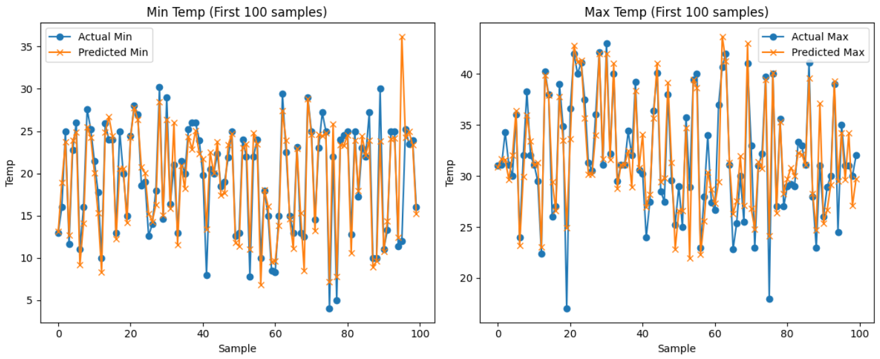
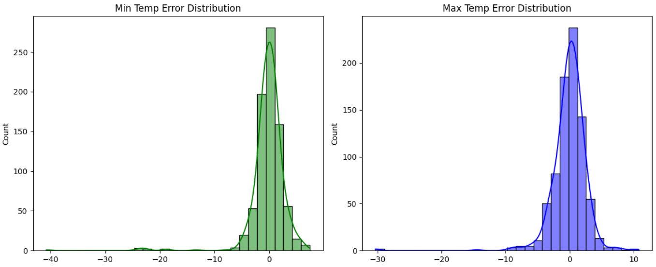
3. Regression Model’s

Slide 34
3. Regression Model’s
4. Lasso Regression
4.1 Introduction
This report presents an analysis of a machine learning model developed to predict daily minimum and maximum temperatures using Lasso Regression. The model employs historical weather data to forecast the next day's temperature extremes, utilizing a multi-output regression approach to simultaneously predict both minimum and maximum temperature values.
4.2 Objective
The primary objective of this project is to develop a predictive model that can accurately forecast the next day's minimum and maximum temperatures based on historical weather patterns and features. The model aims to provide reliable temperature predictions that could be useful for weather forecasting applications, agricultural planning, or general meteorological analysis.
4.3 Libraries & Modules Used
The implementation utilizes the following Python libraries and modules:
pandas: Data manipulation and analysis, CSV file reading
numpy: Numerical computing and array operations
matplotlib.pyplot: Data visualization and plotting
seaborn: Statistical data visualization and enhanced plotting
sklearn.metrics: Performance evaluation metrics (MAE, MSE, R² score)
sklearn.model_selection: Data splitting functionality (train_test_split)
sklearn.linear_model: Lasso regression implementation
sklearn.multioutput: Multi-output regression wrapper (MultiOutputRegressor)
4.4 Scope and Limitations
Scope of Lasso Regression Algorithm
Feature Selection: Automatically performs feature selection by shrinking coefficients of less important variables to zero
Regularization: Prevents overfitting through L1 penalty, improving generalization
Multi-output Capability: Can handle multiple target variables simultaneously when wrapped with MultiOutputRegressor
Interpretability: Provides clear coefficient values for understanding feature importance
Efficiency: Computationally efficient for datasets with moderate dimensionality

Slide 35
3. Regression Model’s
Limitations of Lasso Regression Algorithm
Linear Relationships: Assumes linear relationships between features and targets, may miss non-linear patterns
Feature Correlation: Tends to arbitrarily select one feature from highly correlated feature groups
Alpha Sensitivity: Performance heavily depends on proper alpha (regularization strength) tuning
Scaling Dependency: Requires feature scaling as L1 penalty is sensitive to feature magnitudes
Limited Complexity: Cannot capture complex interactions between variables without explicit feature engineering
Temporal Dependencies: Does not inherently account for time-series patterns in weather data
4.5 Implementation
The implementation follows a standard machine learning pipeline with the following key steps:
Data Preparation: Weather data was loaded from 'ready_to_use_data_for_regression.csv' and split into features (X) and targets (y). Features included all weather variables except 'Next_Min' and 'Next_Max', which served as the prediction targets.
Data Splitting: The dataset was divided into training (80%) and testing (20%) sets using stratified sampling with a fixed random state for reproducibility.
Model Architecture: A MultiOutputRegressor wrapper was applied to the Lasso regression algorithm to enable simultaneous prediction of both minimum and maximum temperatures.
Training Process: The model was trained on the training dataset using the fit method, allowing the Lasso algorithm to learn the relationships between input features and target temperatures.
Prediction and Visualization: Predictions were generated on the test set, followed by comprehensive visualization including actual vs. predicted comparisons and error distribution analysis.
Hyperparameters
The model implementation utilized the following hyperparameter configuration:
Alpha (α) = 0.1: Regularization strength parameter controlling the degree of feature selection and coefficient shrinkage
Random State = 42: Ensures reproducible train-test splits
Train Size = 0.8: Allocates 80% of data for training and 20% for testing

Slide 36
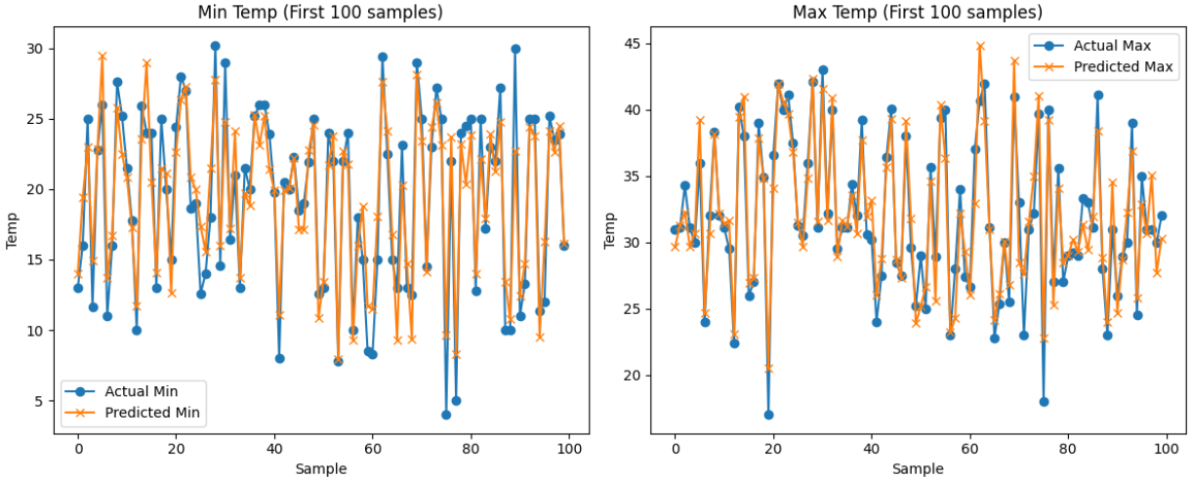
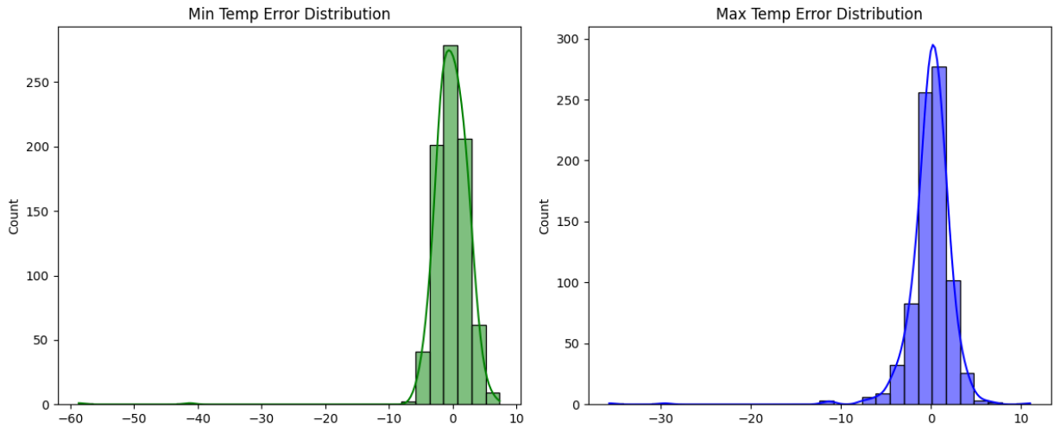
3. Regression Model’s
4.6 Results :
MAE: 1.73 °C
MSE: 9.11
RMSE: 3.02 °C
R² Score: 0.75

Slide 37
3. Regression Model’s
5. Linear Regression
5.1 Introduction
This notebook builds a baseline multi-output linear regression model to predict next-day minimum and maximum temperatures from historical weather features, evaluates its performance, and visualizes prediction accuracy and error distributions.
5.2 Objective
Predict two targets simultaneously: Next_Min and Next_Max.
Evaluate model performance using MAE, MSE, RMSE, and R² on a held-out test set.
Visualize
-> Actual vs predicted values for the first 10 test samples (for both targets).
-> Error distributions for each target to inspect bias and variance.
5.3 Libraries & Modules Used
Data handling and visualization:
pandas (data loading/manipulation)
numpy (numerical operations)
seaborn (statistical plots)
matplotlib.pyplot (visualization)
Modeling and evaluation (scikit-learn):
train_test_split (data splitting)
LinearRegression (base estimator)
MultiOutputRegressor (multi-target wrapper)
mean_absolute_error, mean_squared_error, r2_score (metrics)
5.4 Scope and Limitations of the Algorithm (Linear Regression with MultiOutputRegressor)
Scope :
Captures linear relationships between features and targets efficiently.
Fast to train and predict; scales well to large datasets.
Interpretable coefficients (if examined), enabling insight into feature influence.
Multi-output setup enables training a single model to predict multiple targets, keeping a unified pipeline.
Useful as a strong baseline before moving to more complex models.

Slide 38
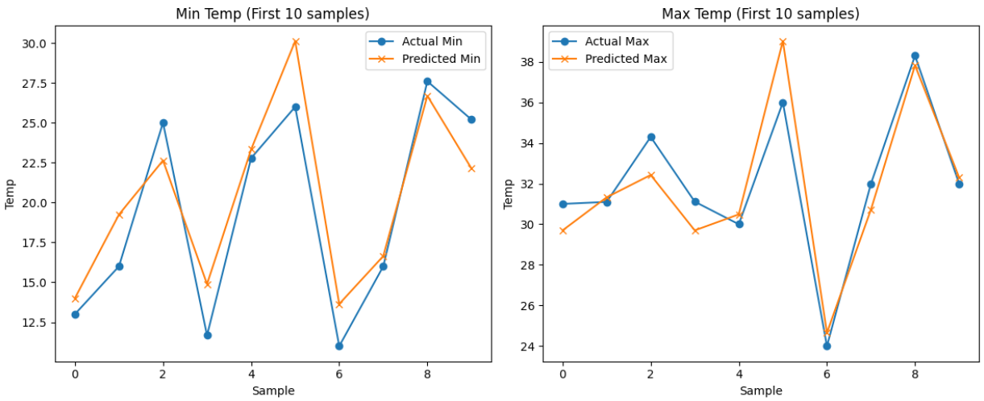
3. Regression Model’s
Limitations:
Linearity assumption: Cannot capture non-linear relationships or complex interactions without feature engineering (polynomial terms, interactions).
Error assumptions: Sensitive to heteroscedasticity (non-constant variance) and non-normal residuals; may degrade performance.
Outliers: Highly sensitive; outliers can skew coefficients and predictions.
Multicollinearity: Correlated features can lead to unstable coefficients and reduce interpretability.
Target dependence: MultiOutputRegressor fits one independent linear model per target; it does not explicitly model the correlation structure between targets.
Hyperparameters
random_state = 42
n_jobs = 2 (parallelism for computation)
Notes: MultiOutputRegressor itself supports n_jobs for parallel fitting across targets; setting n_jobs=-1 there could further speed training.
5.5 Results :
MAE: 1.73 °C
MSE: 8.88
RMSE: 2.98 °C
R² Score: 0.76

Slide 39
3. Regression Model’s
6. Multilayer Perceptron Regressor
6.1 Introduction
This report presents an analysis of a Multi-layer Perceptron (MLP) regression model implemented for weather temperature prediction. The study focuses on predicting future minimum and maximum temperatures using historical weather data through a neural network-based approach. The implementation utilizes scikit-learn's MLPRegressor wrapped in a MultiOutputRegressor to handle the multi-target prediction task.
6.2 Objective
The primary objective of this analysis is to develop and evaluate a neural network-based regression model capable of predicting both minimum and maximum temperatures for future time periods. The model aims to:
Predict Next_Min and Next_Max temperature values simultaneously
Evaluate the performance of MLP regression for multi-output weather forecasting
Assess the accuracy and reliability of neural network predictions through various evaluation metrics
6.3 Libraries & Modules Used
The implementation utilizes the following Python libraries and modules:
pandas: Data manipulation and analysis, used for loading and handling the weather dataset
seaborn: Statistical data visualization, employed for creating error distribution plots
numpy: Numerical computing, used for mathematical operations and array handling
matplotlib.pyplot: Data visualization, used for creating prediction comparison plots
sklearn.metrics: Performance evaluation metrics (MAE, MSE, R² score)
sklearn.model_selection: Data splitting functionality (train_test_split)
sklearn.neural_network: MLPRegressor implementation for neural network regression
sklearn.multioutput: MultiOutputRegressor wrapper for multi-target regression

Slide 40
3. Regression Model’s
6.4 Scope and Limitations
Scope :
Capable of learning complex non-linear relationships between input features and target variables
Effective for multi-output regression tasks through appropriate wrapper classes
Flexible architecture allowing customization of hidden layers and neurons
Built-in regularization capabilities to prevent overfitting
Suitable for continuous target variable prediction
Limitations:
Requires careful hyperparameter tuning (learning rate, architecture, iterations)
Prone to overfitting with insufficient regularization or excessive model complexity
Sensitive to feature scaling and data preprocessing requirements
Computationally intensive compared to linear regression methods
Black-box nature makes interpretation of feature importance challenging
6.5 Implementation
Hyperparameters
hidden_layer_sizes: (100, 50) - Two hidden layers with 100 and 50 neurons respectively
max_iter: 500 - Maximum number of iterations for convergence
random_state: 42 - Ensures reproducible results across multiple runs
Wrapper: MultiOutputRegressor to handle dual-target prediction
Model Architecture
Input Layer: Accepts all feature variables from the dataset
Hidden Layer 1: 100 neurons with default ReLU activation
Hidden Layer 2: 50 neurons with default ReLU activation
Output Layer: 2 neurons for Next_Min and Next_Max predictions
6.6 Results
Mean Absolute Error (MAE): 1.93 °C
Mean Squared Error (MSE): 10.75
Root Mean Squared Error (RMSE): 3.28 °C
R² Score: 0.70

Slide 41
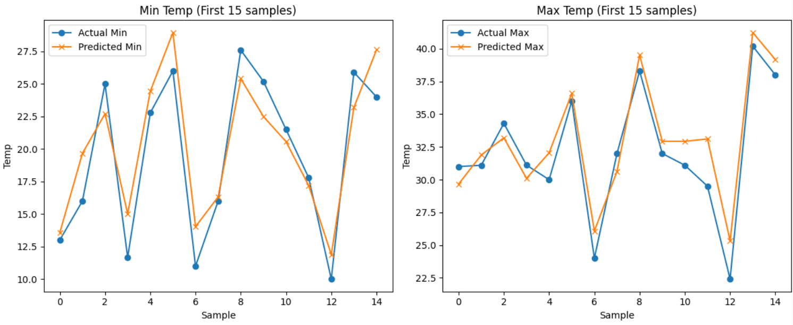
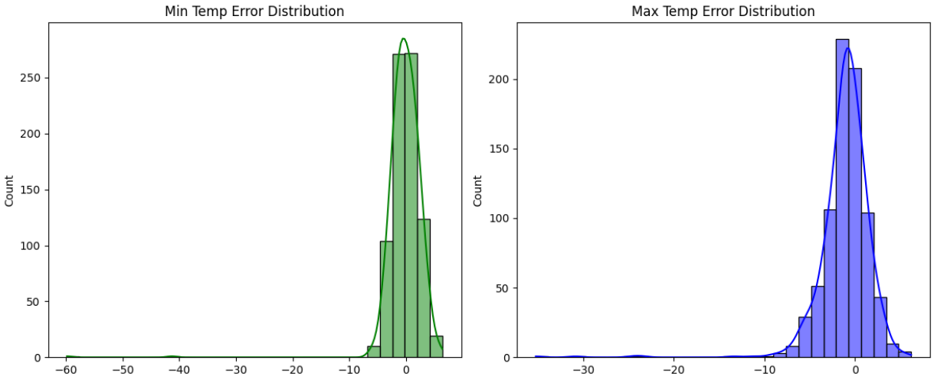
3. Regression Model’s

Slide 42
3. Regression Model’s
7. Random Forest Regression
7.1 Introduction
This report presents an analysis of a Random Forest Regression model applied to predict minimum and maximum temperatures based on weather data. The model leverages ensemble learning techniques to improve prediction accuracy and robustness.
7.2 Objective
The primary objective of this analysis is to develop a predictive model that accurately forecasts the next minimum and maximum temperatures using historical weather data. This can assist in better planning and decision-making in various sectors affected by weather conditions.
7.3 Libraries & Modules Used
Pandas: For data manipulation and analysis.
Seaborn: For data visualization.
NumPy: For numerical operations.
Matplotlib: For plotting graphs.
Scikit-learn: For implementing machine learning algorithms, including:
RandomForestRegressor: For regression tasks.
MultiOutputRegressor: To handle multiple output predictions.
Metrics for model evaluation: mean_absolute_error, mean_squared_error, r2_score.
train_test_split: For splitting the dataset into training and testing sets.
7.4 Scope and Limitations
Scope
Versatility: Random Forest can handle both regression and classification tasks, making it applicable to various predictive modeling scenarios.
Feature Importance: The model provides insights into feature importance, helping to identify which variables significantly impact temperature predictions.
Robustness: It is less prone to overfitting compared to single decision trees, especially with a large number of trees.
Handling Non-linearity: The algorithm can capture complex relationships in the data due to its ensemble nature.

Slide 43
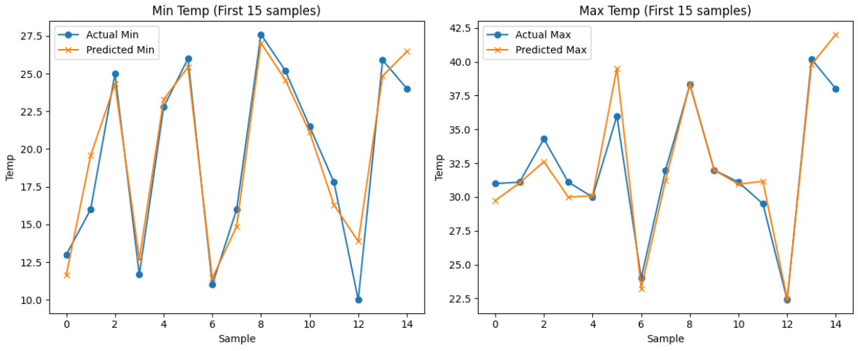
3. Regression Model’s
Limitations
Computationally Intensive: Training a large number of trees can be time-consuming and require significant computational resources.
Interpretability: While it provides feature importance, the overall model is less interpretable compared to simpler models like linear regression.
Sensitivity to Noisy Data: The model can be affected by outliers and noisy data, which may lead to inaccurate predictions.
Memory Usage: Random Forest models can consume a lot of memory, especially with large datasets and many trees.
7.5 Implementation
Hyperparameter Tuning
The model uses RandomForestRegressor with the following hyperparameters:
random_state=42: Ensures reproducibility of results.
n_estimators=100: Specifies the number of trees in the forest.
7.6 Results :
MAE: 1.28 °C
MSE: 4.94
RMSE: 2.22 °C
R² Score: 0.86

Slide 44
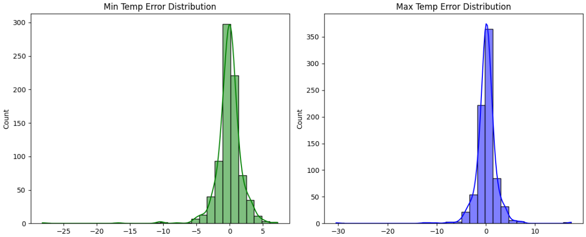
3. Regression Model’s

Slide 45
3. Regression Model’s
8. Ridge Regression
8.1 Introduction
This report summarizes the implementation of a Ridge Regression model to predict the minimum and maximum temperatures based on weather data. The model utilizes a multi-output regression approach to handle the prediction of two target variables simultaneously.
8.2 Objective
The primary objective of this project is to develop a predictive model that accurately forecasts the next day's minimum and maximum temperatures using historical weather data. This can assist in better planning and decision-making related to weather-dependent activities.
8.3 Libraries & Modules Used
Pandas: For data manipulation and analysis.
NumPy: For numerical operations.
Matplotlib: For data visualization.
Seaborn: For enhanced data visualization.
Scikit-learn: For machine learning functionalities, including model training and evaluation.
8.4 Scope and Limitations
Scope
Multi-Output Prediction: The model can predict multiple target variables (Next_Min and Next_Max) simultaneously, making it efficient for related predictions.
Regularization: Ridge regression includes a regularization parameter that helps prevent overfitting, especially in datasets with multicollinearity.
Scalability: The model can be applied to larger datasets, making it suitable for real-world applications in weather forecasting.
Interpretability: The linear nature of Ridge regression allows for easier interpretation of the model coefficients, providing insights into the influence of different features.

Slide 46
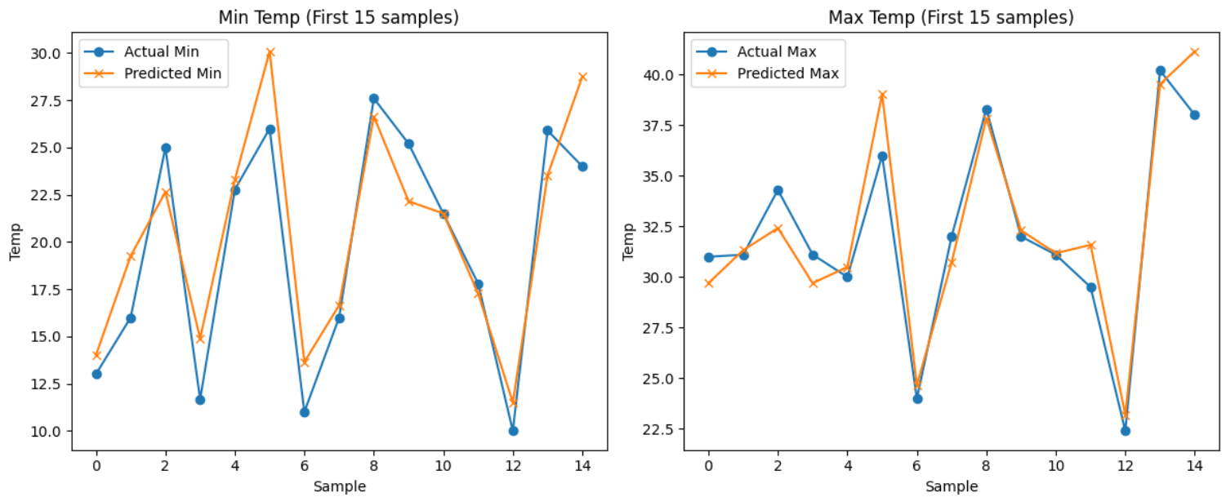
3. Regression Model’s
Limitations
Linearity Assumption: Ridge regression assumes a linear relationship between the features and the target variables, which may not capture complex patterns in the data.
Sensitivity to Outliers: The model can be sensitive to outliers, which may skew the predictions and affect the overall performance.
Hyperparameter Tuning: The performance of the model heavily relies on the choice of the regularization parameter (alpha), which requires careful tuning.
Limited to Regression Tasks: Ridge regression is specifically designed for regression problems and cannot be directly applied to classification tasks.
8.5 Implementation & Result
Hyperparameter
Alpha: The regularization strength parameter is set to 1.0 in this implementation. The solver used is 'sag', which is efficient for large datasets.
8.6 Results
MAE: 1.72 °C
MSE: 8.89
RMSE: 2.98 °C
R² Score: 0.76

Slide 47
3. Regression Model’s
9. Support Vector Regression
9.1 Introduction
This report presents an analysis of weather prediction using Support Vector Regression (SVR). The model aims to forecast the minimum and maximum temperatures based on historical weather data. SVR is a powerful regression technique that can capture complex relationships in data, making it suitable for this task.
9.2 Objective
The primary objective of this analysis is to develop a predictive model that accurately estimates the next day's minimum and maximum temperatures using historical weather data. The model's performance will be evaluated using various metrics to ensure its reliability.
9.3 Libraries & Modules Used
Pandas: For data manipulation and analysis.
Seaborn: For data visualization.
NumPy: For numerical operations.
Matplotlib: For plotting graphs.
Scikit-learn: For implementing machine learning algorithms, including:
SVR for Support Vector Regression.
train_test_split for splitting the dataset.
mean_absolute_error, mean_squared_error, and r2_score for performance evaluation.
StandardScaler for feature scaling.
MultiOutputRegressor for handling multiple output regression.
9.4 Scope and Limitations
Scope :
Multi-output Regression: The model can predict multiple outputs (Next_Min and Next_Max) simultaneously, making it efficient for weather forecasting.
Non-linear Relationships: SVR can capture non-linear relationships in the data, which is beneficial for complex weather patterns.
Robustness to Outliers: SVR is less sensitive to outliers compared to other regression techniques, improving prediction accuracy.
Scalability: The model can be scaled to include more features or larger datasets without significant changes to the underlying algorithm.

Slide 48
3. Regression Model’s
Limitations
Parameter Tuning: SVR requires careful tuning of hyperparameters (e.g., kernel type, epsilon) to achieve optimal performance, which can be time-consuming.
Computational Complexity: The training time can be high for large datasets, making it less suitable for real-time predictions.
Interpretability: The model's predictions can be difficult to interpret, as SVR does not provide insights into feature importance.
Assumption of Stationarity: The model assumes that the relationships in the data remain constant over time, which may not hold true in dynamic weather conditions.
9.5 Implementation
Hyperparameter Tuning
The model uses a Radial Basis Function (RBF) kernel with a cache size of 300 and an epsilon value of 0.5. These parameters were chosen to balance model complexity and performance.
Implementation
Data Preparation: The dataset is loaded, and features are separated from the target variables (Next_Min and Next_Max).
Train-Test Split: The data is split into training (80%) and testing (20%) sets.
Model Training: A pipeline is created that includes feature scaling and the SVR model wrapped in a MultiOutputRegressor.
Prediction: The model predicts the temperatures for the test set.
9.6 Results :
MAE: 1.37 °C
MSE: 4.89
RMSE: 2.21 °C
R² Score: 0.86

Slide 49
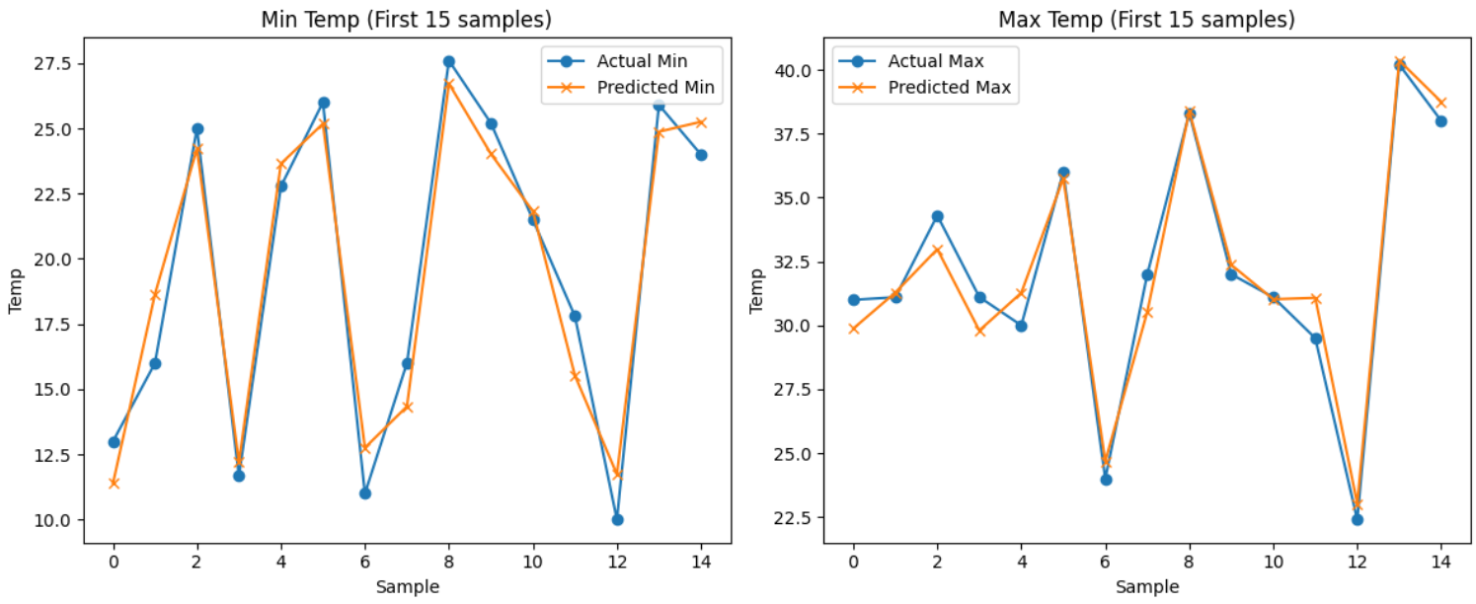
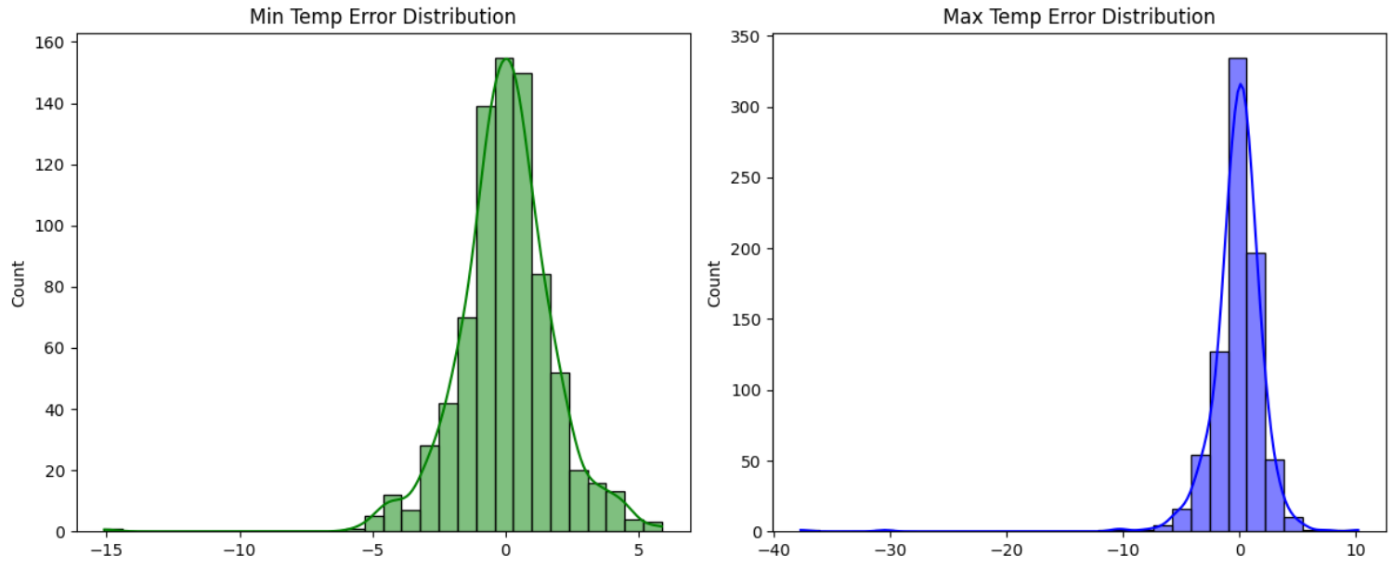
3. Regression Model’s

Slide 50
4. Weather Prediction
1. Rainfall occurrence & Rainfall Amount Prediction
1.1 Introduction
This project implements a two-stage machine learning approach for rainfall prediction using XGBoost algorithms. The system first predicts the occurrence of rain (binary classification) and then estimates the rainfall amount for rainy days (regression). The analysis utilizes historical weather data including temperature, humidity, and meteorological parameters to build predictive models for weather forecasting applications.
1.2 Objective
The primary objectives of this project are:
Binary Classification: Predict whether rain will occur on a given day (0 = No Rain, 1 = Rain)
Regression Modeling: Estimate the amount of rainfall (in mm) for days when rain is predicted to occur
Model Performance Evaluation: Assess the accuracy and reliability of the prediction models using appropriate metrics.
1.3 Libraries & Modules Used
The following Python libraries and modules were implemented:
pandas: Data manipulation and CSV file handling
numpy: Numerical computations and mathematical operations
seaborn: Statistical data visualization
matplotlib.pyplot: Plotting and graph generation
xgboost: XGBClassifier and XGBRegressor for model implementation
sklearn.model_selection: train_test_split for data splitting
sklearn.metrics: Performance evaluation metrics (accuracy_score, confusion_matrix, r2_score, mean_absolute_error, mean_squared_error, root_mean_squared_error)
1.4 Scope and Limitations
Scope
Binary Rain Prediction: Effectively classifies rainy vs non-rainy days with high accuracy using ensemble learning
Rainfall Amount Estimation: Provides quantitative rainfall predictions for identified rainy days

Slide 51
4. Weather Prediction
Feature Engineering: Incorporates temporal features (Year, Month, Day) for enhanced prediction capability
Robust Data Handling: Implements comprehensive data preprocessing including missing value imputation and outlier management
Limitations
Limited Feature Set: Relies primarily on temperature and basic meteorological data, lacking advanced atmospheric parameters
Temporal Dependency: May not capture complex seasonal patterns or long-term climate trends effectively
Regional Specificity: Model performance may be limited to the geographical region of the training data
Regression Performance: Moderate R² score (0.43) indicates room for improvement in rainfall amount prediction accuracy
1.5 Implementation
Data Preprocessing
The implementation began with comprehensive data cleaning procedures:
Removal of irrelevant features ('cloud cover')
Conversion of string columns to numeric format
Missing value imputation using median values for continuous variables
Temporal feature extraction (Year, Month, Day) from date columns
Binary filtering to retain only clear rain/no-rain classifications (0, 1)
Model Architecture
Classification Model (Rain Occurrence)
Algorithm: XGBoost Classifier
Target Variable: 'Rainy Days' (Binary: 0/1)
Features: Max/Min temperature, Morning/Evening conditions, PE (Potential Evapotranspiration), temporal features
Data Split: 80% training, 20% testing with stratified sampling
Regression Model (Rainfall Amount)
Algorithm: XGBoost Regressor
Target Variable: 'Rain' (Continuous: rainfall in mm)
Dataset: Filtered to include only rainy days (Rainy Days = 1)
Features: Same as classification model excluding 'Rain' target

Slide 52
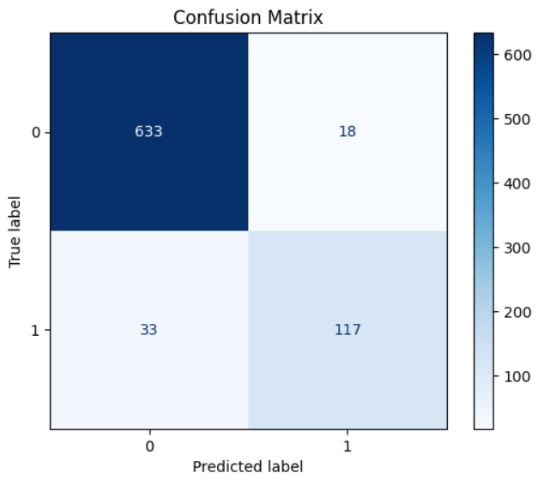
4. Weather Prediction
Hyperparameters :
XGBoost Classifier
max_depth: 19 (tree depth for complexity control)
n_estimators: 100 (number of boosting rounds)
eval_metric: 'mlogloss' (evaluation metric)
use_label_encoder: False (deprecated feature disabled)
XGBoost Regressor
n_estimators: 2300 (extensive boosting rounds)
gamma: 8 (minimum split loss threshold)
max_depth: 8 (controlled tree depth)
eta: 0.5 (learning rate)
device: 'cuda' (GPU acceleration)
1.6 Results
Classification Results (Rain Occurrence)
Dataset Size: 3,204 samples after preprocessing
Class Distribution:
Training: 2,606 no-rain days, 598 rainy days
Testing: 651 no-rain days, 150 rainy days
Model Accuracy: High accuracy achieved -> 93.63%
Evaluation: Confusion matrix visualization confirmed model performance

Slide 53
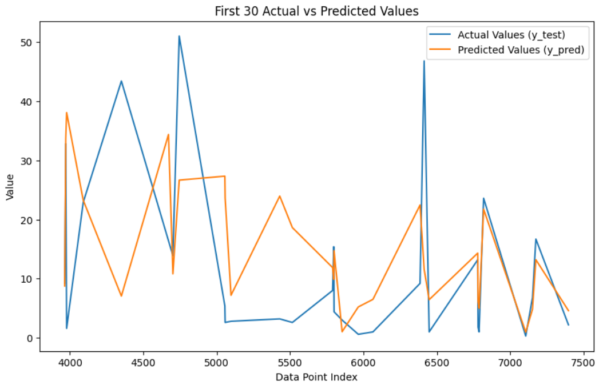
4. Weather Prediction
Regression Results (Rainfall Amount)
Mean Absolute Error (MAE): 13.08 mm
R² Score: 0.43 (43% variance explained)
Root Mean Square Error (RMSE): 23.42 mm

Slide 54
4. Weather Prediction
2. Weather Forecasting using Arima & XGBoost
2.1 Introduction
This report analyzes a weather forecasting project that implements machine learning techniques to predict maximum daily temperatures. The project utilizes historical weather data to build predictive models using both traditional time series analysis (ARIMA) and modern machine learning approaches (XGBoost Regressor).
2.2 Objective
The primary objective of this project is to forecast the next day's maximum temperature using historical weather data. The project aims to compare the performance of different forecasting approaches and provide accurate temperature predictions for weather planning and analysis.
2.3 Libraries & Modules Used
pandas: Data manipulation and analysis
numpy: Numerical computations and array operations
matplotlib.pyplot: Data visualization and plotting
statsmodels.tsa.arima.model (ARIMA): Time series forecasting model
statsmodels.tsa.stattools (adfuller): Stationarity testing
statsmodels.graphics.tsaplots: ACF and PACF plotting for time series analysis
xgboost (XGBRegressor): Gradient boosting regression model
sklearn.metrics: Model evaluation metrics (MAE, RMSE, MSE)
2.4 Scope and Limitations
ARIMA Model
Scope:
Effective for univariate time series forecasting.
Suitable for stationary data with linear relationships.
Provides interpretable results with statistical significance testing.
Good baseline model for temperature forecasting tasks.
Limitations:
Limited to single feature analysis (only maximum temperature)
Assumes linear relationships and may miss complex patterns
Requires data stationarity and may struggle with irregular seasonal patterns
Performance degrades with longer forecast horizons

Slide 55
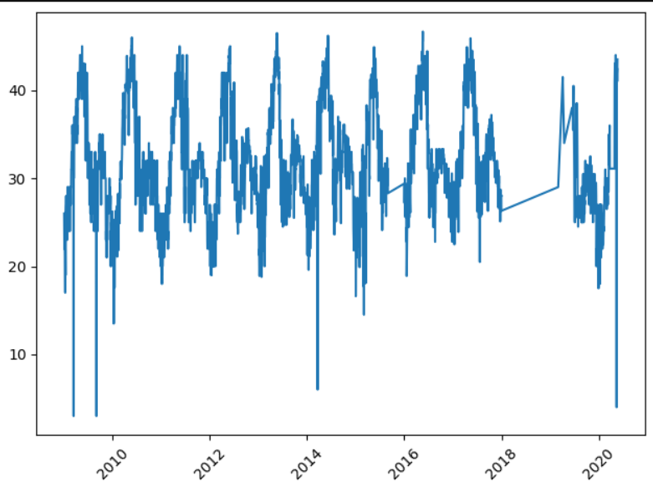
4. Weather Prediction
XGBoost Regressor
Scope:
Handles multiple features simultaneously for comprehensive weather prediction
Captures non-linear relationships and complex interactions between variables
Robust to outliers and missing values in weather data
Provides feature importance analysis for weather pattern understanding
Limitations:
Requires careful feature engineering and hyperparameter tuning
Less interpretable compared to traditional time series models
May overfit with insufficient data or poor feature selection
Computationally intensive for large datasets and real-time predictions
Pattern Observed on Max Temp

Slide 56
4. Weather Prediction
2.5 Implementation
Data Preprocessing
The implementation began with comprehensive data cleaning, including:
Removal of irrelevant features (cloud cover)
Conversion of numeric columns and handling missing values
Median imputation for missing temperature and weather metrics
Date formatting and temporal sorting
ARIMA Model Implementation
Stationarity Testing: Applied Augmented Dickey-Fuller test
Parameter Selection: Used PACF and ACF plots to determine optimal parameters
Model Configuration: ARIMA(2,0,3) based on correlation analysis
Training Split: Used first 3,950 observations for training
XGBoost Implementation
Feature Engineering: Created lagged variables and temporal features
Feature Set: Max_lag1, Min_lag1, Rain_lag1, Rainy_Days_lag1, Next_Month, Next_DayOfYear
Training Split: 3,000 observations for training, remainder for testing
Hyperparameters
max_depth: 5 (controls tree complexity)
learning_rate: 0.1 (step size shrinkage)
n_estimators: 100 (number of boosting rounds)
subsample: 0.8 (fraction of samples for each tree)
colsample_bytree: 0.8 (fraction of features for each tree)
random_state: 42 (reproducibility)
2.6 Results
ARIMA Model Performance
Forecast Period: 10 days
Test Range: Observations 3950-3960
Results :
MEA : 0.059
RMSE : 0.063

Slide 57
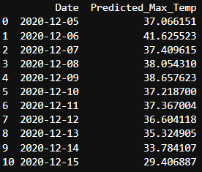
4. Weather Prediction
XGBoost Model Performance
Forecast Capability: 30-day ahead predictions
Feature Utilization: Multi-variate approach using lagged weather variables
Evaluation Metrics:
MAE : 3.03
RMSE : 4.29
Output: Generated forecast with predicted maximum temperatures
2.7 Conclusion :
The XGBoost model demonstrated superior capability in handling multiple weather variables and providing longer-term forecasts, while the ARIMA model served as a reliable baseline for univariate temperature prediction. Both models provide complementary approaches to weather forecasting with different strengths in temporal pattern recognition and feature utilization.

